Slide 1
CONVOLUTIONAL NEURAL NETWORK (CNN)

Slide 2
Convolutional Neural Network (CNN)
CNN is a Deep Learning algorithm which can take in an input image, assign importance (learnable weights and biases) to various aspects/objects in the image and be able to differentiate one from the other.
The pre-processing required in a CNN is much lower as compared to other classification algorithms.
While in primitive methods filters are hand-engineered, with enough training, CNN have the ability to learn these filters/characteristics.
The architecture of CNN is analogous to that of the connectivity pattern of Neurons in the Human Brain and was inspired by the organization of the Visual Cortex.

Slide 3
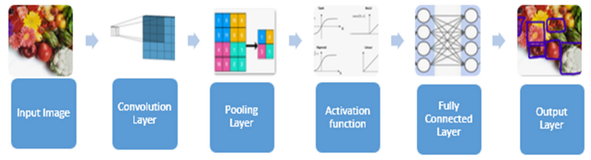
CNN Components

Slide 4
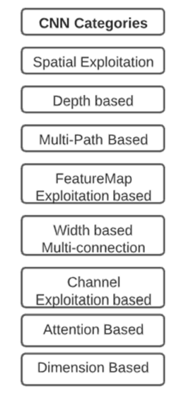
ARCHITECTURAL EVOLUTION OF CNN
Spatial Exploitation - spatial filters were used by investigators to increase performance.
Depth based – Number of hidden layers.
Multipath based - Shortcut connections or numerous pathways can have a connection from one layer to another analytically by evading some in-between levels, allowing for the customized flow of information between the layers. The network is split into the sections using cross-layer connectivity. Addresses Vanishing gradient problem.
Feature Map Exploitation based - some of the feature maps have little or no function in object discrimination. Excessive feature sets may provide a noise effect, leading to the over-fitting of the network. In addition to network engineering, the selection of feature maps can play a crucial role in CNN architecture.

Slide 5
ARCHITECTURAL EVOLUTION OF CNN
Width based Multi-connection – Emphasis on adjusting the network width for better learning.
Exploitation-Based Feature-Map (ChannelFMap) CNNs - In addition to network engineering, the selection of feature maps can play an essential role in increasing the network performance. CNN selects features dynamically by adjusting the weights linked with a kernel.
Attention based CNN - Attention in the convolutional neural network is used to improve representation and overcome computational limitations. RNN and LSTM networks use attention modules as progressive feature.
Dimension-Based CNN - CNN architecture that utilizes dimensional convolutions and dimension-wise fusion. The dimension-wise convolutions apply light-weight convolutional filtering across each dimension of the input tensor while dimension-wise fusion efficiently combines these dimension-wise representations;

Slide 6
ARCHITECTURAL EVOLUTION OF CNN
Spatial Exploitation-Based CNN – LeNet (1998), AlexNet (2012), ZfNet (2014), VGG (2014), GoogleNet (2015).
Depth + width based CNN - InceptionV-3 (2015), Inception V-4 (2016).
Depth + Multi-Path based CNN - Highway Network (2015), ResNet (2016).
Depth + Width + Multi-Path based CNN - Inception ResNet (2016).
Multi-Path based CNN - Deluge Net (2016), Fractal Net (2016).
Width based CNN - WideResNet (2016), Xception (2017), ResNext (2017).
Attention based CNN - Residual Attention Neural Network (2017).
Feature Map Exploitation based CNN - Squeeze and Excittation Network (2017).
Dimension based CNN – EdgeNet (2019), ESPNetV2 (2019), DiceNet (2021)

Slide 7
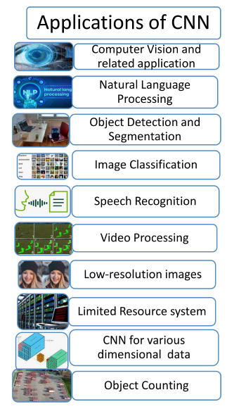
Applications of CNN

Slide 8
REFERENCE

